Slide 1
统计机器翻译介绍
（1）

Slide 2
outline
统计机器翻译简介：历史和现状
统计机器翻译基本理论
IBM的统计机器翻译模型1-3
GIZA++的使用
IBM的统计机器翻译模型4-5
解码器的概述
基于短语的统计翻译模型
翻译质量的自动评价

Slide 3
机器翻译的一点历史
Machine translation was one of the first applications envisioned for computers
Warren Weaver (1949): “I have a text in front of me which is written in Russian but I am going to pretend that it is really written in English and that it has been coded in some strange symbols. All I need to do is strip off the code in order to retrieve the information contained in the text.”
First demonstrated by IBM in 1954 with a basic word-for-word translation system

Slide 4
机器翻译方法
多年来人们提出很多机器翻译方法
  基于规则(RBMT)
  基于实例(EBMT)
  基于统计(SMT)
目前的主流方法是基于统计。基于统计和基于实例的方法也称为数据驱动(data-driven)的方法，或经验(empirical)方法
我们只探讨基于统计的方法

Slide 5
统计机器翻译的历史
虽然，Weaver的备忘录造成了机器翻译的第一次热潮，但是，由于机器容量的限制，一直到80年代末，才由IBM的Brown等人实现了第一个符合Weaver精神的统计机器翻译系统。这是smt的第一个里程碑
Brown等人的论文在1990年发表计算语言学杂志上。1993年， Brown等人又对里面的数学原理进行了详细的描述，也发表计算语言学杂志上。

Slide 6
Candide 系统
1994年，IBM的Berger等人发表了Candide统计机器翻译系统，与著名的systran系统比较如下
 | 流畅 | 忠实
 | 1992 1993 | 1992 1993
Systran | .466 .540 | .686 .743
Berger的系统 | .511 .580 | .575 .670
Berger的机器辅助翻译系统Transman | .819 .838 | .837 .850
人工翻译 | .833 | .840
表摘自姚天顺
教授的幻灯片

Slide 7
SMT的第二个里程碑
IBM的结果在很长的时间里面没有人能够重复。
1999年，在USC/ISI的Kevin Knight 得带领下，召开了著名的 SMT 1999 Workshop，重复了 IBM 的工作，并且公开了大部分结果（包括源代码）
http://www.clsp.jhu.edu/ws99/projects/mt/
我认为这是SMT的第二个里程碑，此后SMT正式中兴，并且在2000年后占据了MT研究的主流地位

Slide 8
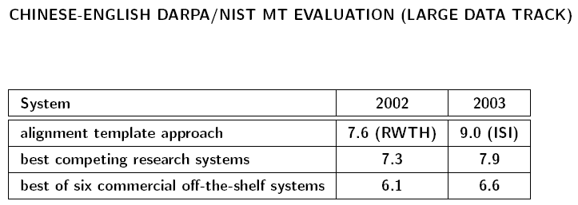
NIST MT 评测
2002年以后的NIST评测中，统计机器翻译已经超过了传统的方法

Slide 9
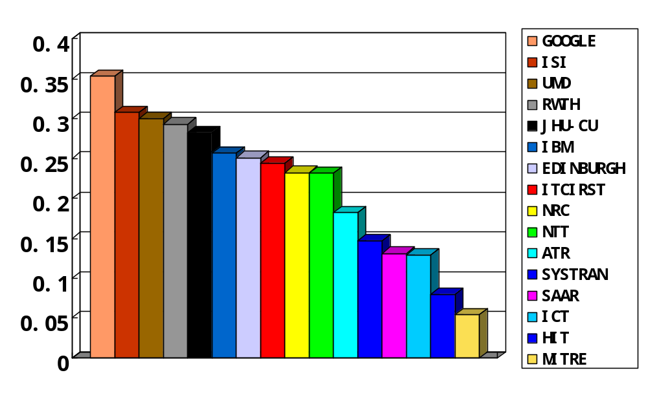
NIST评测(2005)
2005国内两家：计算所、哈工大
2006年：计算所、自动化所、厦大
国内是计算所最好，我们有一定差距

Slide 10
统计机器翻译的基本理论
主要介绍IBM模型 1-5
研究从法语 f 翻译成英语 e（IBM系统处理的语言）
你可以把f理解为foreign(如汉语)，有时候我们也举汉语的例子
材料主要取自Kevin Knight的A Statistical MT Tutorial Workbook

Slide 11
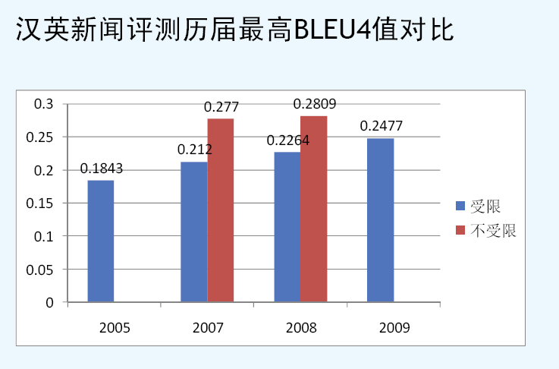
CWMT评测

Slide 12
notations
e: english
f: french
P(e): The probability that someone speaks e. e.g.
P(‘I like snakes’)
P(f|e): The probability that a translator will produce f upon seeing e. e.g.
P(‘maison bleue’ |‘I like snakes’)
P(e, f): joint probability. if e and f are independent, we have P(e, f) = P(e) * P(f)

Slide 13
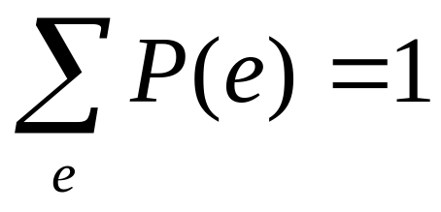
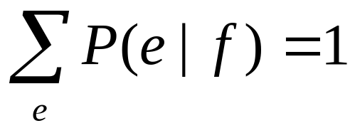
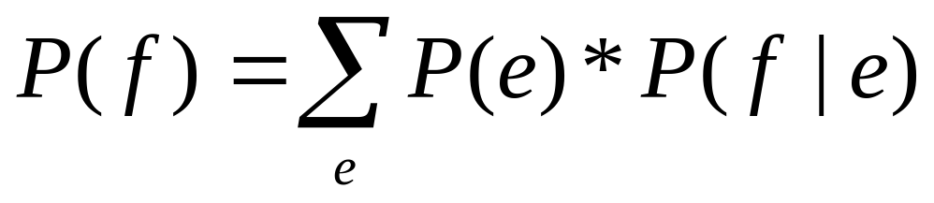
facts about probabilities
Notes:
You can read the last one like this: “Suppose f is influenced by some event. Then for each possible influencing event e, we calculate the chance that (1) e happened, and (2) if e happened, then f happened. To cover all possible influencing events, we add up all those chances.

Slide 14
our aim: french-english MT
Given a French sentence f, we seek the English sentence e that maximizes P(e | f). we write:
argmax P(e | f)
e
sometimes we write this as ê
统计机器翻译认为，所有的e都可能是f的翻译，寻找最优翻译变成一个搜索问题。

Slide 15
noisy channel model
Bayes Rule:
P(e|f) = P(e) * P(f | e) / P(f)
argmax P(e | f) = argmax P(e) * P(f | e)
e e
The noisy channel works like this: We imagine that someone has e in his head, but by the time it gets on to the printed page it is corrupted by “noise” and becomes f. To recover the most likely e, we reason about (1) what kinds of things people say any English, and (2) how English gets turned into French.

Slide 16
Bayesian Reasoning
though we want
argmax P(e | f)
e
we calculate P(e) and P(f | e)
breaking it into two parts makes the work easier:

Slide 17
P(e): we assign a high value to it only if e is grammatical.
P(f|e): we assign a high value to P(f | e) only if the words in f are generally translations of words in e. We probably need not care about word orders in e. (that is handled by P(e)) e.g. we can assume P(f|’the boy runs’)=P(f|’runs boy the’)
This is called bag-of-words approach.
Notes:
we need to be able to turn a bag of French words into a bag of English words, and assign a score of P(f | e) to the bag-pair. bag-of-words cannot handle “John loves Mary” and “Mary loves John”.

Slide 18
P(e) worries about good English. It is called Language Model.
P(f|e) worries about French that matches English. It is called Translation Model.
The two can be trained independently

Slide 19
On voit Jon à la télévision
 | good English? P(e) | good match to French? P(f|e)
Jon appeared in TV. |  | ✓
Appeared on Jon TV. |  | ✓
In Jon appeared TV. |  | ✓
Jon is happy today. | ✓
Jon appeared on TV. | ✓ | ✓
TV appeared on Jon. |  | ✓
TV in Jon appeared. |  | ✓
Jon was not happy. | ✓

Slide 20
quiz
is bag-of-words approach correct?
words in a sentence has orders!
周老师的例子：
  狗放屁
  放屁狗
  放狗屁
因此“好”的模型还是需要语序的！

Slide 21
language model
we need to build a machine that assigns a probability P(e) to each English sentence e.
we need a corpus to have a language model
n元模型是一个常用的语言模型。我们已经讲过了；PCFG也是一个可用的语言模型

Slide 22
n-gram models
n=2, bigram; n=3; trigram
P(e) = P(e1, e2, …, eL) = P(e1) P(e2|e1) … P(eL|e1 … eL-1) ≈
P(e1) P(e2|e1) … P(eL|eL-1) (bigram)
p(y | x) ≈ number-of-occurrences(“xy”) / number-of-occurrences(“x”)
Notes:
If n=1, nerds say unigram, and normal people say word.

Slide 23
P(I like snakes that are not poisonous) ≈
  p(I | start-of-sentence) *
  p(like | I) *
  p(snakes | like) *
  ...
  p(poisonous | not) *
  p(end-of-sentence | poisonous)
  [bigram model]

Slide 24
P(I like snakes that are not poisonous) ≈
  p(I | start-of-sentence start-of-sentence) *
  p(like | start-of-sentence I) *
  p(snakes | I like) *
  ...
  p(poisonous | are not) *
  p(end-of-sentence | not poisonous) *
  [trigram model]

Slide 25
Translation Modeling
we need to compute P(f|e)
we tell a “generative” story about how English strings become French strings.
normal syntactic story: an English sentence gets parsed syntactically. This tree is then transformed into a French tree. English words are then replaced by French translations.
IBM model 3: first English words are replaced by French translations, which are then scrambled around.

Slide 26
IBM model 3
We can't propose that English words are replaced by French words one for one, because then French translations would always be the same length as their English counterparts.
So we have to allow that an English word may produce more than one French word, or perhaps no French words at all.

Slide 27
IBM model 3 story
1. For each word e_{i} in an English sentence (i = 1 ... l), we choose a fertility Φ_{i}. The choice of fertility is dependent solely on the English word in question. It is not dependent on the other English words in the English sentence, or on their fertilities.
2. For each word ei, we generate Φ_{i} French words. The choice of French word is dependent solely on the English word that generates it. It is not dependent on the English context around the English word. It is not dependent on other French words that have been generated from this or any other English word.

Slide 28
3. All those French words are permuted. Each French word is assigned an absolute target “position slot.” For example, one word may be assigned position 3, and another word may be assigned position 2 - the latter word would then precede the former in the final French sentence. The choice of position for a French word is dependent solely on the absolute position of the English word that generates it.

Slide 29
Translation as String Rewriting
Mary did not slap the green witch
选择fertility(not has fertility 2):
Mary’ did’ not’ not’ slap’ the’ green’ witch’
生成单词翻译：
Mary a ne pas giflé la verte sorcière
排列单词位置：
Mary ne a pas giflé la sorcière verte
译文后处理：
Mary n'a pas giflé la sorcière verte

Slide 30
parameters in model 3
t(maison | house) word translation probability
n(1 | house) fertility probability
d(5 | 2, l, m) distortion probability

Slide 31
we note that some French words can mysteriously appear in a translation although no English word can really be held responsible for them. For example, function words such as “que”
to model this phenomenon, we pretend that every English sentence contains the invisible word NULL in the initial, zero-th position. We have parameters like t(maison | NULL) that give the probability of generating various words spuriously from NULL.

Slide 32
do we have to use parameters like n(3|NULL)?
But we note that longer sentences will have more spurious words.
so, instead of n(0 | NULL) ... n(25 | NULL), we're going to have a single floating-point parameter called p1

Slide 33
You can think of p1 like this. After we assign fertilities to all the “real” English words (excluding NULL), we will be ready to generate (say) z French words. As we generate each of these z words, we optionally toss in a spurious French word also, with probability p1. We'll refer to the probability of not tossing in (at each point) a spurious word as p0 = 1 - p1.

Slide 34
Finally, we need to worry about distortion probabilities for NULL-generated words. It is too simple to have parameters like d(5 | 0, 4, 6), i.e., the chance that the NULL word will generate a French word that winds up in French position 5 as opposed to some other position. These spurious words can appear anywhere! It's fruitless to try to predict it! We'll instead (1) use the normal-word distortion parameters to choose positions for normally-generated French words, and then (2) put the NULL-generated words into the empty slots that are left over. If there are three NULL-generated words, then there are 3! ways for slotting them all in. We'll just assign a probability of 1/6 for each way.

Slide 35
whole generative Model 3
1. For each English word e_{i} indexed by i = 1, 2, ..., l, choose fertility Φ_{i} with probability n(Φ_{i} | e_{i}).
2. Choose the number Φ₀ of “spurious” French words to be generated from e₀ = NULL, using probability p1 and the sum of fertilities from step 1.
3. Let m be the sum of fertilities for all words, including NULL.
4. For each i = 0, 1, 2, ..., l, and each k = 1, 2, ..., Φ_{i}, choose a French word tau-ik with probability t(tau-ik | e_{i}).

Slide 36
5. For each i = 1, 2, ..., l, and each k = 1, 2, ..., Φ_{i}, choose target French position pi-ik with probability d(pi-ik | i,l,m).
6. For each k = 1, 2, ..., Φ₀, choose a position pi-0k from the Φ₀ - k + 1 remaining vacant positions in 1, 2, ... m, for a total probability of 1/ Φ₀!.
7. Output the French sentence with words tau-ik in positions pi-ik (0 <= i <= l, 1 <= k <= Φ_{i} )

Slide 37
example
input:
Mary did not slap the green witch
choose fertilities=>
Mary not slap slap slap the green witch
choose number of spurious words=>
Mary not slap slap slap NULL the green witch
choose translations=>
Mary no daba una botefada a la verde bruja
choose target positions=>
Mary no daba una botefada a la bruja verde

Slide 38
Model 3 Parameters
You can see that the model has four types of parameters: n, t, d, and p1.
There's nothing mysterious about a model: it's mostly just a bunch of numbers!
but how to estimate these parameters?

Slide 39
Key to parameter estimation: Alignments
two problems:
  First, how can we automatically obtain parameter values from data?
  Second, armed with a set of parameter values, how can we compute P(f | e) for any pair of sentences?
if we have word-aligned e and f, we can computer parameters

Slide 40
Alignment Example
NULL And the program has been implemented
Le programme a ete mis en application
we can calculate t and n

Slide 41
comments
in model 3, every French word is connected to exactly one English word (either a regular word or NULL). So, it's never the case that two English words jointly generate some French word. ( That means model 3 is not an accurate model of translation.)
an alignment can be represented as a vector of length m(=length of french sentence)

Slide 42
Alignment Example
NULL And the program has been implemented
Le programme a ete mis en application
a=[2, 3, 4, 5, 6, 6, 6 ]

Slide 43
comments
Notice that the word-for-word alignment does not quite preserve all of the model's decisions in transforming an English sentence into a French one. For example, if a single English word x is connected to French words y and z, then we don't really know whether they were generated in that order, or whether they were generated as z and y, then permuted.

Slide 44
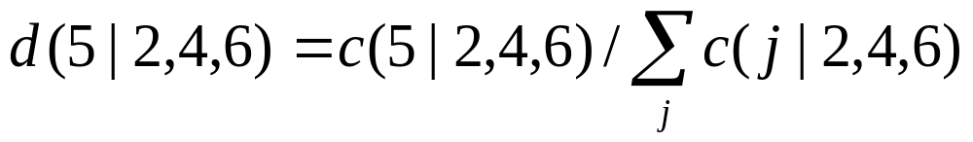
Estimating Parameter Values from Word-for-Word Alignments
It is also easy to estimate d parameter values. e.g.

Slide 45
The last thing to estimate is p1. To do this, we can consider the entire French corpus of N words. Suppose that M of those words were generated by NULL, according to the alignments provided. (The other N-M were generated by normal English words). Then, we can imagine that after each normally generated French word, a spurious word will be generated in M of the N-M cases, so p1 = M / N-M.

Slide 46
all possible alignments
we have only corpus, no alignments
we have to find a best alignment for each pair of sentences
suppose we cannot find one, can we find the good alignments? if that is also hard, can we enumerate all possible alignments?
some alignments are definitely better that others. we should associate a higher probability to those.

Slide 47
possible alignments
The blue house The blue house
0.3 0.6
La maison bleue La maison bleue
The blue house The blue house
0.05 0.05
La maison bleue La maison bleue

Slide 48
fractional counts
when calculating t (or n, d, p), we can associate the alignment probability to a count. Hence the name fractional counts
c(la|the)=0.6+0.3=0.9
c(maison|the)=c(bleue|the)=0.05
P(la|the)=c(la|the)/Σ_{w}c (w|the)=0.9/1=0.9
first, count
second, normalize to make it a probability!

Slide 49
how to compute alignment probability?
if we got t, we can use it to judge whether an alignment is good or not. words in good alignments tend to be translations of each other
P(a | e,f)
= P(a,e,f )/ P(e,f)
=P(e)P(a,f|e)/ P(e)P(f | e)
=P(a,f|e)/P(f|e)
and we have P(f | e) = Σ P(a,f | e)
a
so, in order to compute P(a|e,f), we need P(a,f | e)

Slide 50
attack P(a,f | e)
e = English sentence
f = French sentence
ei = the ith English word
fj = the jth French word
l = number of words in the English sentence
m = number of words in the French sentence
a = alignment (vector of integers a1 ... am, where each aj ranges from 0 to l)

Slide 51
aj = the English position connected to by the jth French word in alignment a
e_{aj} = the actual English word connected to by the jth French word in alignment a
phi-i = fertility of English word i (where i ranges from 0 to l), given the alignment a

Slide 52
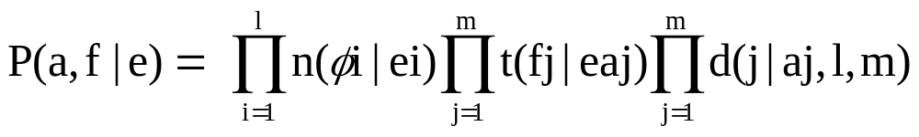
This formula accounts for the basic fertility, word translation, and distortion values implied by the alignment and French string. There are a few problems, however.

Slide 53
problem 1
we should only count distortions which involve French words that were generated by “real” English words, and not by NULL. We should eliminate any d value for which aj = 0.

Slide 54
problem 2
we forgot to include costs for generating “spurious” French words. Any French word fj for which aj = 0 is spurious. There are phi-0 spurious French words, according to the definitions above. Observe that there are m - phi-0 non-spurious French words, i.e., ones that were generated by “real” English words. After each of those m - phi-0 words, we have the option of generating a spurious word with probability p1. How many ways are there to spit out phi-0 spurious words under this process? That's the same as asking how many ways there are to pull phi-0 balls out of a box that contains (m - phi-0) balls.

Slide 55
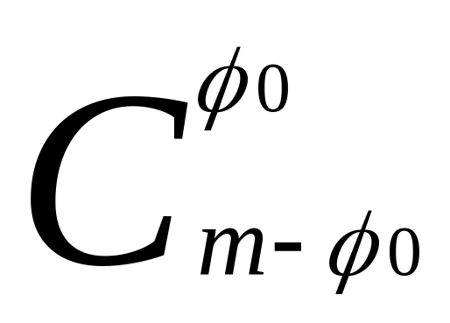
so we need a factor
of couse, we have also a cost: if we take the “add spurious” option phi-0 times, then we have an extra factor of p1^phi-0. And if we take the “don't add spurious” option ((m - phi-0) - phi-0) times, then we have an extra factor of p0^(m - 2 * phi-0).

Slide 56
problem 3
we forgot to include costs for permuting the spurious French words into their final target positions.
we need an additional factor of 1/phi-0!

Slide 57
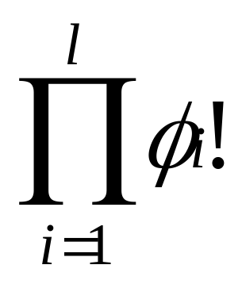
problem 4
remember when an english word aligns with more than one french word, we don’t know the order they are generated.
we need another factor

Slide 58
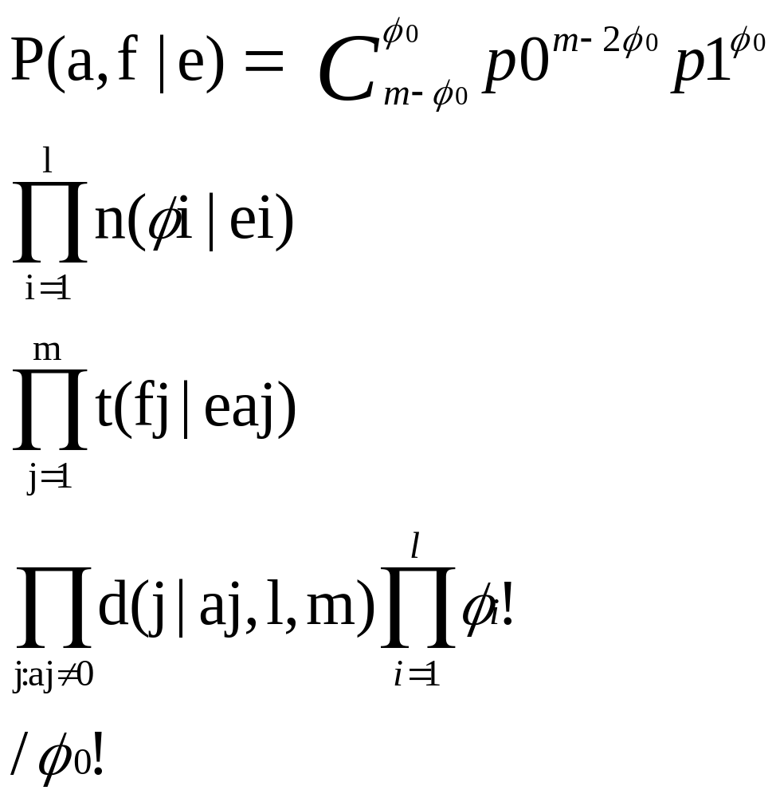
final fomula
p0+p1=1

Slide 59
recall P(a | e,f) = P(a,f | e) / Σ P(a,f | e)
a
So that‘s the whole Model 3 story boiled down to a math formula. It’s a fancy model.比如法语中的对应到空的单词这么产生是不是很奇怪啊
If you can come up with a better story and boil it down to a math formula, then maybe you can get better translations!

Slide 60
Chicken and Egg
if you have alignment probabilities, then you can compute parameter estimates (using fractional counts). The point of last formula is this: if you have parameter values, then you can compute alignment probabilities.
To solve this Chicken and Egg circle, we use EM algorithm

Slide 61
We will begin with uniform parameter values. That is, suppose there are 40,000 words in the French vocabulary. Then we begin with the assumption that t(f | e) = 1/40,000 for every pair of English and French words. Maybe “house” translates to “maison,” or maybe translates to “internationale.” At this point, we have no idea.

Slide 62
We can assign uniform distortion probabilities, pick a random value for p1, say 0.15, and we can assign every English word the same set of fertility probabilities.

Slide 63
EM
Now that we have some initial values, we can compute alignment probabilities for each pair of sentences. That means we can collect fractional counts. When we normalize the fractional counts, we have a revised set of parameter values. Hopefully these will be better, as they take into account correlation data in the bilingual corpus. Armed with these better parameter values, we can again compute (new) alignment probabilities. And from these, we can get a set of even-more-revised parameter values. If we do this over and over, we may converge on some good values.

Slide 64
EM steps
Step 1. Set parameter values uniformly.
t(fj | ei) = 1/|V|
Step 2. Compute P(a,f | e) for all alignments.
Step 3. Normalize P(a,f | e) values to yield P(a | e,f) values.
Step 4. Collect fractional counts.
Step 5. Normalize fractional counts to get revised parameter values.
Repeating steps 2-5 many times

Slide 65
example
assume all possible alignments are:
b c b c
| | X
x y x y
b
|
y
Repeating steps 2-5 many times yields:
t(x | b) = 0.0001
t(y | b) = 0.9999
t(x | c) = 0.9999
t(y | c) = 0.0001

Slide 66
What is EM doing?
Parameters set uniformly will produce a very low P(f | e). As it turns out, each iteration of the EM algorithm is guaranteed to improve P(f | e). That's the number that EM is optimizing in its computations. EM is not guaranteed to find a global optimum, but rather only a local optimum. Where EM winds up is therefore partially a function of where it starts.
It is more convenient to measure the goodness of a model with perplexity: (i iterates over all sentences)
  - Σi log (P(fi|ei)) / N
  2 (N = number of words)
Each EM iteration lowers the perplexity.

Slide 67
model 3 deficiencies
The distortion parameters are a very weak description of word-order change in translation. Words just fly around all over the place. So Model 3 will bet on lots of ungrammatical French sentences. We mentioned above that P(e) will take up some of the slack.

Slide 68
2. The second problem is that Model 3 also lays bets on French sentences that you wouldn't even recognize as natural language at all. In the generative model, remember that we choose a target position slot for each French word (the permutation step). Nothing in the generative story prevents us from selecting target position 7 for every French word, in which case they will all pile up on top of each other, leaving the other target positions empty. Because Model 3 lays bets on such non-strings, better models will look down on it and called it deficient.

Slide 69
Nothing prevents us generate a sentence like:
  This is Possible
好的模型应该避免缺陷
NOT

Slide 70
Practical Problems with Model 3 Training
the EM algorithm needs to iterate over every alignment of every sentence pair. That’s too many.
The solution is to iterate only over a subset of “good-looking” (probable) alignments.
如何找到好的alignment呢？

Slide 71
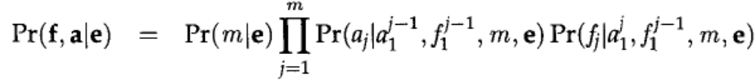
对齐的一般分解公式
当我们从英语句子产生法语的时候，首先根据英语句子选择法语句子长度，然后我们选择与第一个法语单词的位置的对齐，然后选择法语单词本身，然后选择第二个位置，第二个单词,...

Slide 72
我们引入简单的模型1
Model1 story:
由英语句子e 译成法语句子f 的过程为：
  (1) 根据概率分布为法语句子f 选择一个长度m；
  (2) 对于每一个j = 1, 2, …, m，根据均匀分布原则从 0, 1, …, l 中选择一个值给a_{j}；
  (3) 对于每一个 j = 1, 2, …, m，根据概率选择一个法语单词f_{j}。

Slide 73
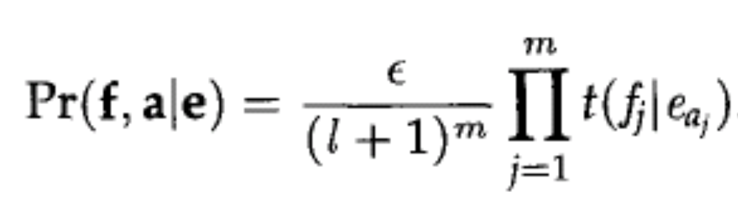
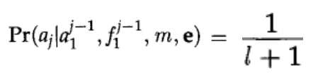

我们引入简单的模型1
we can use model 1 to train some of the parameter values used by model 3.

Slide 74
model 1(kevin)
m m l
P(f | e) =αΣ Π t(fj | eaj) = α Π Σ t(fj | ei)
a j=1 j=1 i=0
模型1：
没有fertility, 一对一对应
distortion 简化为等概率的全对齐

Slide 75
Model 1 概率计算
Step 1: Determine candidates. For each English word e collect all foreign words f that co-occur at least once with e
Step 2: Initialize P(f | e) uniformly, i.e. P(f | e) = 1/(no of co-occurring foreign words)

Slide 76
Model 1 概率计算
Step 3: Iteratively refine translation probabilities:
1 for n iterations
2 tc = 0;
3 for each sentence pair (e,f) of lengths (l,m)
4 for j=1 to m
5 total=0;
6 for i=1 to l
7 total += P(f_{j} | e_{i});
8 for i=1 to l
9 tc(f_{j} | e_{i}) += P(f_{j} | e_{i})/total;
10 for each word e
11 total=0;
12 for each word f s.t. tc(f | e) is defined
13 total += tc(f | e);
14 for each word f s.t. tc(f | e) is defined
15 P(f | e) = tc(f | e)/total;

Slide 77
Best Alignment for Model 1
Remember that P(a | e,f) is computed in terms of P(a,f | e). In Model 1, P(a,f | e) has m factors, one for each French word. Each factor looks like this: t(fj | eaj).
In model 1, we can actually choose an English “home” for each French word independently.
  for 1 <= j <= m,
  aj = argmax t(fj | ei)
  i

Slide 78
Unfortunately, the “best” alignment according to a fully-trained Model 1 may not be very intuitively satisfying. Because each French word chooses its preferred English “home” independently, they may very well all choose English word e5.
The best alignment is also called the Viterbi alignment

Slide 79
practical plan for Model 3 training
uniform t values
|
Model 1 iteration (collect fractional counts over all alignments)
|
revised t values
|
Model 1 iteration (collect fractional counts over all alignments)
|
revised t values
|
............

Slide 80
revised t values uniform n, d, p values
| |
Model 3 (collect fractional counts over a subset alignments,
identified with the help of the Model 1 Viterbi alignment)
|
revised t, n, d, p values
|
Model 3 (collect fractional counts over a subset alignments,
identified with the help of the Model 1 Viterbi alignment)
|
revised t, n, d, p values
|
...
|
final t, n, d, p values

Slide 81
we first train Model 1 for several iterations. When that is done, we find the best alignment for each sentence pair, according to Model 1 parameter values. For each sentence pair, we then re-score the Model 1 Viterbi alignment using the P(a,f | e) formula of Model 3. (If this is the first Model 3 iteration, then we will have to use uniform fertility and distortion probabilities).

Slide 82
Once we have a somewhat reasonable alignment and a Model 3 score, we can consider small changes to the alignment. (For example, changing the connection of f4 from e5 to e7). If a small change improves the Model 3 score, we make that change. We keep changing the alignment (hill climbing) until there is no simple way to improve it anymore. We'll call this the “Viterbi” alignment for Model 3, even though we don't know for a fact that this is the best alignment according to the P(a | e,f) formula of Model 3.

Slide 83
Now we consider this Model 3 Viterbi alignment together with its neighborhood -- those alignments that look very similar to it (are obtainable from very small changes). This gives us a reasonable subset of Model 3 alignments. We can collect fractional counts only over that subset. When we normalize these counts, we have new values of t, n, d, and p1. We can then repeat the process. Again we find the best alignments according to Model 1 and the t values, and we use these alignments to greedily find best Model 3 alignments. Notice that our new values for t feed back into Model 1, and may actually yield new Model 1 Viterbi alignments.

Slide 84
If we want a larger variety of good-looking alignments, we can start up several hill climbers -- each begins at a variant of the Model 1 Viterbi alignment in which a certain connection is manually set and pegged for the duration of the climb.
but Model 1 is too weak. Is there a better model? Fortunately we have model 2.

Slide 85
Model 2
This model involves word translations (like Model 1) but also distortions. But the distortion probabilities in Model 2 are different from the ones in Model 3. Instead of
d(French-position | English-position, English-sentence-length, French-sentence-length)
We will use reverse-distortion probabilities:
a(English-position | French-position, English-sentence-length, French-sentence-length)

Slide 86
m m
P(a,f | e) = Π t(fj | eaj) Π a(aj | j,l,m)
j=1 j=1

Slide 87
To find best Model 2 alignment, we select for each French word fj (independently) the English position i that maximizes the word-translation and distortion factors:
  for 1 <= j <= m,
  aj = argmax t(fj | ei) * a(i | j,l,m)
  i

Slide 88
To compute P(f | e) efficiently, we use factoring-out to do the following rewrite:
m
Σ Π t(fj | eaj) * a(aj | j,l,m) =
a j=1
m l
Π Σ t(fj | ei) * a(aj | j,l,m)
j=1 i=0

Slide 89
Transferring Parameter Values from One Model to Another
we will run Model 1 for several iterations, and then use the resulting “t” values as input to the first Model 2 iteration, instead of uniform t values. This simple idea is called transferring parameter values from one model to another. For the first Model 2 iteration, we will use uniform “a” values.

Slide 90
We would like to use everything we learned in Model 2 iterations to set initial Model 3 parameter values. We can insert a “one time only” special transfer iteration in between Model 2 iterations and Model 3 iterations. During this transfer, in addition to collecting t and a counts, we can collect d, f counts as well.

Slide 91
The Final Training Scheme for model 3
uniform t values
|
Model 1 iteration (collect fractional counts over all alignments)
|
revised t values
|
Model 1 iteration (collect fractional counts over all alignments)
|

Slide 92
revised t values uniform a values
| |
Model 2 iteration (collect fractional counts over all alignments)
|
revised t and a values
|
Model 2 iteration (collect fractional counts over all alignments)
|
revised t and a values
|

Slide 93
Model 2->3 (one time only transfer of parameter values)
| |
revised t and a values initial n, d, p values
| |
Model 3 (collect fractional counts over a subset of alignments, identified with the help of the Model 2 Viterbi alignment)
|
revised t, a, n, d, p values
|

Slide 94
Model 3 (collect fractional counts over a subset of alignments, identified with the help of the Model 2 Viterbi alignment)
|
revised t, a, n, d, p values
|
... more and more iterations ...
|
final t, a, n, d, p values

Slide 95
小结
到此为止，我们主要介绍了统计机器翻译的基本原理，和IBM Model 1,2,3的参数估计方法
IBM模型4-5我们下面再介绍。
这些模型训练已有公开源代码的工具： GIZA++

Slide 96
GIZA++
GIZA++是Och为主编写的，是在1999年JHU机器翻译讨论班的基础上改进的。
网址：http://www.fjoch.com/
可移植到Windows上，用VC编译。（2004一学生Bluegene 做的工作）
直接在cygwin下也可编译。
可以训练IBM Model 1-6（模型6参见Och的博士论文）

Slide 97
GIZA++演示
语料库的准备
英语分词
汉语分词
训练演示

Slide 98
工具
ec: 把双语文本转化为两个单语文件的工具
corpus_sep: 把语料库分成训练集、开发集、测试集的工具（邹丰美老师开发）
tokenize：英语分词工具
segtag: 汉语分词工具
pregiza: 集成了tokenize 和segtag
plain2snt: 改造过的词汇生成工具，比giza++原来的同名工具快
giza: 训练工具

Slide 99
作业
访问Kevin Knight的主页。
阅读有关参考文献，特别是Brown 1993的文章:Brown93 Peter F. Brown, Stephen A. Della Pietra, Vincent Della J. Pietra, and Robert L. Mercer. The mathematics of Machine Translation: Parameter estimation. Computational Linguistics, 19(2):263-312, June 1993.
。

Slide 100
problem of model 3
虽然model 3 允许一个英语单词翻译成多个法语单词(fertility)，因此可以模拟一个英语单词翻译成一个法语词组的情形，但是，这些法语单词的位置d(j|a_{j}, l, m)是无关的
而词组之间单词的位置显然是相关的。比如，移动的时候，要作为一个整体移动。
model 4考虑了这种相关性

Slide 101
head
如果一个英语单词对应于几个法语单词，最左边的那个称为head.
把d(j|a_{j}, l, m)分成两参数，1）确定head的位置d₁；2）d_{>1}确定其他单词的位置，这些单词依赖于head
head的位置依赖于前面那个英语单词的位置，那个英语单词的类别，以及对应的法语单词的类别

Slide 102
the blue house 翻译成 maison bleu，可见单词的位置与前一个单词相关,这些相关性一般还与词类有关
d₁ (k-j|class(e_{i-1}), class(f_{k})) 其中k是当前单词ei对应的位置，j是e_{i-1}对应的位置（如果e_{i-1}对应了几个法语单词，则j是他们的位置的平均值），class是词类函数
请注意，这里d变成了相对位置，而原来是绝对位置

Slide 103
Brown设计了一个算法，把英语和法语单词分为50类
d_{>1} (k-j|class(f_{k}))，其中k是非head单词对应的位置，j是head或前一个非head单词对应的位置，class是词类函数
例如，not经常翻译成ne pas，而且中间一般有其他单词隔开，而implemented 经常翻译成词组 mis en application，因此
d_{>1} (2|class(pas)) 应当> d_{>1} (2|class(en))

Slide 104
显然，pas的位置与ne也有关系，而Model 4忽略了这一点，不考虑head的词类!
Model 4要求非head单词的相对位置>0
注意，原来在model 3 中，一组单词有Φ_{i} ！种排列法，现在只有一种了。

Slide 105
几个概念
move: 两个对齐a和a’除了存在一个j, aj ≠aj’，其他都一样，称其differ by a move
swap: 两个对齐a和a’除了存在两个j1, j2, 使aj1 =aj2’, aj2=aj1’，其他都一样，称其differ by a swap
邻居：两个对齐，至多differ by a move or by a swap
一个对齐a的所有邻居集合为N(a)

Slide 106
JHU Workshop 99 的最后报告中，给出了在模型3的情形，从a的概率计算a的邻居的概率的方法

Slide 107
b(a)=argmax(P(b|f,e))
b∈N(a)
同理定义b_{i←j}(a)，这里j一定对应于i,i和j称为pegged
我们可以定义b(a), b(b(a))=b²(a),...,最后概率最大的称为b∞(a)，同理定义b_{i←j}∞ (a)

Slide 108
定义S=N(b∞(V(f|e;2)))∪
∪_{ij} N(b_{i←j}∞ (V _{i←j}(f|e;2)))
V(f|e;2)指模型2的Viterbi对齐
上面公式的第一项是对V(f|e;3)的近似。我们计算模型3的时候，只对S中的alignment进行计算。这个公式源自Brown的论文。
当然，在计算模型3的时候，我们是用模型3的概率来计算模型2的Viterbi对齐的

Slide 109
如何训练model 4的参数？
从模型3到模型4，同样采用这样的办法。
首先， Model 4的初始参数来自 Model 3
利用Model 4的参数，找到model 2的viterbi 对齐。 再求b∞(a|e,f;4)等（当然求的时候我们只能把模型4的参数当成模型3来使用）。最后normalize得到新的概率

Slide 110
Model 5
Model 3是deficient，Model 4 也是。因为d1(-1|...)不为0，导致产生第一个位置以前也能出现单词，同理最后一个单词以后也能出现单词，当然几个单词叠在同一个位置也是可能的。
Model 5对Model 4作出修改，保证不会出现这种情况。也就是说，计算位置概率的时候，引入一个新的随机变量，表示现在法语句子中还没有英语单词对齐的空位，只有当新的位置处于这些空位位置的时候，概率才>0，否则=0

Slide 111
训练Model 5的参数的时候，也是从Model 2的Viterbi对齐开始，但是利用了模型5的参数。

Slide 112
IBM模型的讨论
Fertility is asymmetric
  Often a single French word corresponds to several English words.
    Eg) “to go” is translated as “aller”.
Independence assumption
  By this assumption, the model gives an unfair advantage to short sentences because fewer probabilities are multiplied.
Sensitivity to training data
  Small changes in the model and the training data can cause large changes in the estimates of the parameters.
  Questions about how close the training text and the text of application need to be in order to get acceptable results.

Slide 113
No notion of phrases
  The model relates only individual words.
Non-local dependencies
  Non-local dependencies are hard to capture with ‘local’ models like n-gram models. So even if the translation model generates the right set of words, the language model will not assemble them correctly.
Morphology
  Morphologically related words are treated as separated symbols.
Sparse data problems
  Since parameters are solely estimated from the training corpus without any help from other sources of information

Slide 114
统计机器翻译系统的几个步骤
1、建立统计模型
语言模型，翻译模型
2、进行模型的参数训练
3、建立解码器，寻找解

Slide 115
Decoding
We can learn parameters values for computing P(e) from monolingual English text. We can learn parameter values for computing P(f | e) from bilingual sentence pairs. To translate an observed French sentence f, we seek the English sentence e which maximizes the product of those two terms. This process is called decoding. It's impossible to search through all possible sentences, but it is possible to inspect a highly relevant subset of such sentences.

Slide 116
decodeing
stack-based decoding
greedy decoder
Dynamic programming decoding

Slide 117
stack decoder
问题：给定法语句子，如何找到最可能的英语翻译？
算法：
  在栈上放一个空的英语句子
  从栈顶取出分数最大的句子
  如果该句子完整了，结束
  用每一个可能的英语单词扩展句子，计算该部分句子的分数，压入栈，返回2

Slide 118
当然这其实不是一个栈，应该称为priority queue.
计算一个部分句子的分数分成两部分：
  部分句子的概率分数
  未出现的后半部分句子的概率分数
这是一个典型的AI启发式搜索问题，我们知道，有一个算法称为A*，可以找到最优解

Slide 119
A*解码
王野翊提出了一个估算分数的模型
H＝l: e1, e2, ... ek
score(H)=g(H)+h(H)
S_{H}(j)=εΣ_{i=0,k}t(fj|ei)a(i|j,l,m)
对某个法语单词的贡献. 他采用模型2
g(H)=Σ_{j=0,m}log S_{H}(j) + Σ_{i=0,k}logP(e_{i}|e_{i-N+1}...e_{i-1})

Slide 120
按照算法A*的要求， h(H)的估算必须是所有e_{k+1}...e_{l}的分数的上界
h(H)=Σ_{j=1,m}max{0,log(...)}-(l-k)Perplexity_{train} + C
具体公式参见他的论文：decoding algorithm in statistical machine translation

Slide 121
Ulrich Dermann等人提出了一种greedy搜索方法，并不求最优解
首先，找出每个法语单词最可能的英语翻译，组成一个英语句子，如法语 Bien entendu, il parle de une belle victoire对应的近似翻译为 well heard, it talking a beautiful victory
然后通过改变对齐方式和相应的翻译候选单词来改进这个近似翻译

Slide 122
他们探索了几种操作：
  改变某一个或两个法语单词的翻译
  改变某个法语单词的翻译并插入一个新的英语单词
  删除某个feitility=0的英语单词
  交换某两个英语短语的位置
  .....
这样导致了一个非常快的算法

Slide 123
动态规划解码
假设翻译是单调的，那么可以采用非常快速的解码算法
  动态规划

Slide 124
Phrase-based Translation
Translating “word by word” fails to take into account context
Local context is often captured by phrases
Split the sentences into phrases and translate the phrases

Slide 125

Translation model
Assume we have a way to identify phrases
Use the general model on phrases:
  One to one phrase alignment
  Phrases are contiguous
  Introduce a hidden variable S as a way to give a segmentation of pair (f₁^{J}; e₁^{I}) in K phrases

Slide 126
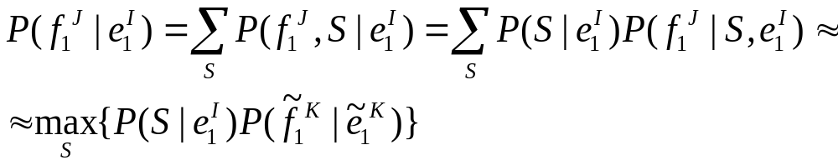
Translation model, continued
The sum over all segmentations is approximated with the maximum
Because usu. Only 1 segmentation is correct

Slide 127
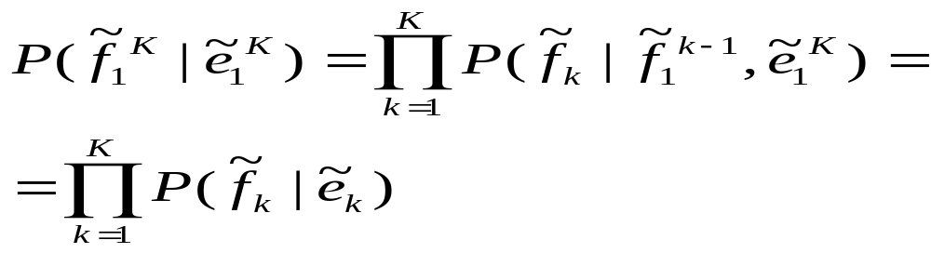
Translation model, continued
Now, which phrase maps into which?
  Assume monotone translation, no reordering
This leads to

Slide 128
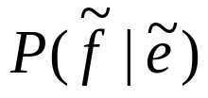
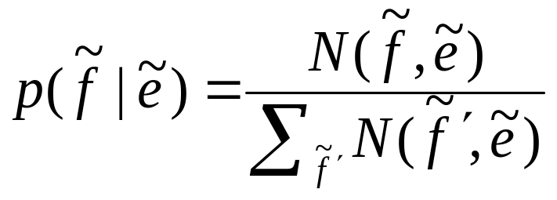
Translation model, estimation
The computation reduces to estimating
Which is done based on frequency
N(f,e) = instances where f is translated e

Slide 129
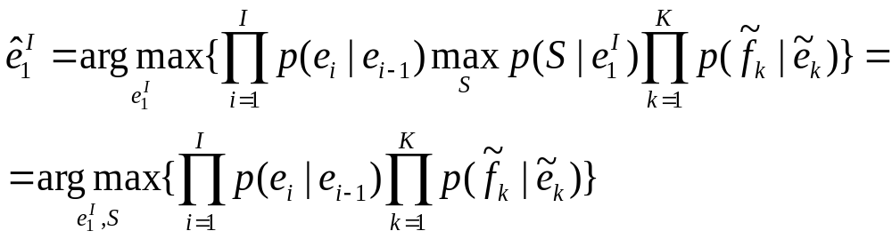
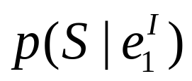
Translation model, estimation(II)
Using a bigram language model and Bayes decision rule, the search criterion becomes
by considering constant

Slide 130
经典短语模型的解码
采用动态规划
容易得到nbest结果

Slide 131
短语到模板
单纯的短语不能处理生语料。可以把短语中的单词用类来代替，这样就得到了Och的所谓“对齐模板”
这不但降低了复杂度，而且提高了generalization ability

Slide 132
开源统计机器翻译系统
Moses
  Philipp Koehn et. al. 2007
  State-of-the art SMT system
  C++ & Perl implementation of
    Phrase-based SMT ( Pharaoh )
    Factor phrase-based decoder
    Minimum error rate training
    Translation Model training
  License : LGPL
  http://www.statmt.org/moses/

Slide 133
开源统计机器翻译系统
Silk road 丝路
“丝路”（Silk Road）是一个基于短语的汉英统计机器翻译系统。该系统由中国的五家研究机构和高校联合开发（中科院计算所、中科院自动化所、中科院软件所、厦门大学、哈尔滨工业大学），并在2006 年中国第二届统计机器翻译研讨会上发布，供国内外研究者共享使用。

Slide 134
汉英统计机器翻译问题
冠词问题
单复数问题
时态问题
省略问题

Slide 135
作业
下载Moses并学会使用
访问Koehn的统计机器翻译阅读组
http://people.csail.mit.edu/koehn/smt/

Slide 136
机器翻译的评测
Extrinsic
  通过其他用途来评价MT。如跨语言搜索？
Intrinsic
  人工评价：贵，准
  机器评价：便宜，只能近似评价翻译质量
目前最常用的自动评价是IBM提出来的BLEU

Slide 137
Bilingual Evaluation Understudy (BLEU)
Central Idea:
  “The closer a machine translation is to a professional human translation, the better it is.”
BLEU was proposed by Papineni 2002
Scores are calculated for individual translated segments—generally sentences—by comparing them with a set of good quality reference translations. Those scores are then averaged over the whole corpus to reach an estimate of the translation's overall quality.

Slide 138
What is BLEU? A Big Picture
Requires multiple good reference translations
Depends on modified n-gram precision
  precision: n-grams in the candidate translation appear in any reference sentences
Computes Per-corpus n-gram precision
  n can have several values and a weighted sum is computed
  n=1: adequacy
  n>1: fluency
Penalizes very brief translation

Slide 139
N-gram Precision: an Example
Candidate 1: It is a guide to action which ensures that the military always obey the commands the party.
Candidate 2: It is to insure the troops forever hearing the activity guidebook that party direct.
which is better?
Reference 1: It is a guide to action that ensures that the military will forever heed Party commands.
Reference 2: It is the guiding principle which guarantees the military forces always being under the command of the Party.
Reference 3: It is the practical guide for the army always to heed directions of the party

Slide 140
BLEU – Example : Unigram Precision
Candidate 1: It is a guide to action which ensures that the military always obey the commands of the party.
Reference 1: It is a guide to action that ensures that the military will forever heed Party commands.
Reference 2: It is the guiding principle which guarantees the military forces always being under the command of the Party.
Reference 3: It is the practical guide for the army always to heed directions of the party.
N-gram Precision : 17/18

Slide 141
Example : Unigram Precision (cont.)
Candidate 2: It is to insure the troops forever hearing the activity guidebook that party direct.
Reference 1: It is a guide to action that ensures that the military will forever heed Party commands.
Reference 2: It is the guiding principle which guarantees the military forces always being under the command of the Party.
Reference 3: It is the practical guide for the army always to heed directions of the party.
N-gram Precision : 8/14

Slide 142
Issue of N-gram Precision
What if some words are over-generated?
  e.g. “the”
An extreme example
Candidate: the the the the the the the.
Reference 1: The cat is on the mat.
Reference 2: There is a cat on the mat.
N-gram Precision: 7/7 (Something wrong)
Intuitively : reference word should be exhausted after it is matched.

Slide 143
Modified N-gram Precision : Procedure
Procedure
  Count the max number of times a word occurs in any single reference
  Clip the total count of each candidate word
  Modified N-gram Precision equal to
    Clipped count/Total no. of candidate word
Example:
Ref 1: The cat is on the mat.
Ref 2: There is a cat on the mat.
“the” has max count 2
Unigram count = 7
Clipped unigram count = 2
Total no. of counts = 7
Modified-ngram precision:
  Clipped count = 2
  Total no. of counts =7
  Modified-ngram precision = 2/7

Slide 144
Different N in Modified N-gram Precision
N > 1 is computed in a similar way
  When 1-gram precision is high, the reference tends to satisfy adequacy
  When longer n-gram precision is high, the reference tends to account for fluency
  N=4: highest correlation with monolingual human judgements

Slide 145
Modified N-gram Precision on Blocks of Text
A source sentence could be translated as multiple target sentences
Procedure in evaluation:
Compute the N-gram matches sentence by sentence
Add the clipped counts for all candidate sentences
Divide the sum by the total number of n-grams in the candidates

Slide 146
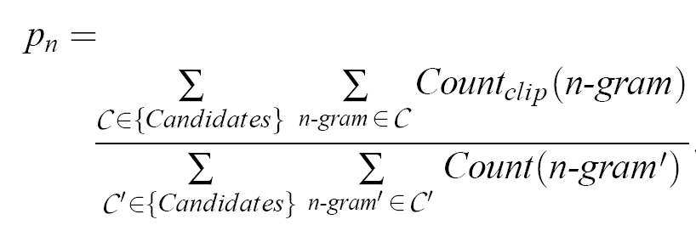
Formula of
Corpus-based N-gram Precision
Note: Candidate means translated sentences

Slide 147
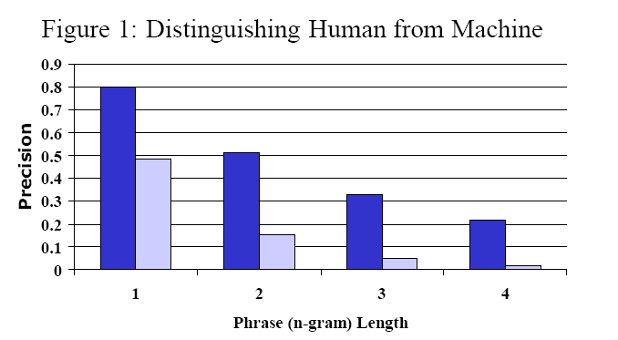
Experiment 1 of N-gram Precision:
Can it differentiate good and bad translation?
Source : Chinese, Target: English
Human (Blue) vs (Machine) Light Blue
Observation: Human scores much better than Machine
Conclusion: BLEU is useful for translation with great difference in quality.

Slide 148
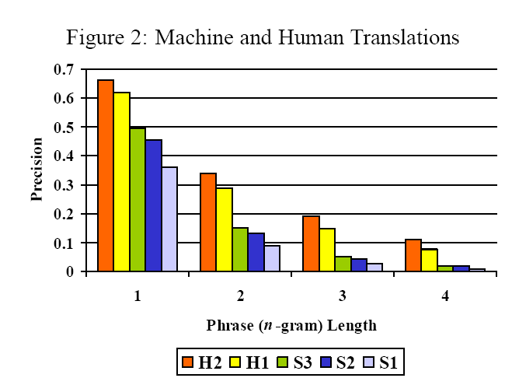
Experiment 2 of N-gram Precision:
Can it differentiate with very close quality?
From BLEU: H2 > H1 > S3 > S2 > S1
Same as human judgment
Conclusion: It is still quite useful when quality is similar

Slide 149
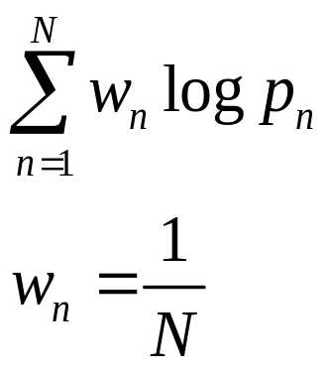
Combining modified n-gram precision
Precision has exponential decay
  So use geometric means
4-gram was shown to be the best among (3,4,5)-gram
  So N=4

Slide 150
Issues of Modified N-gram Precision : Sentence Length
Candidate 3: of the
Modified Unigram Precision : 2/2
Modified Bigram Precision : 1/1
Reference 1: It is a guide to action that ensures that the military will forever heed Party commands.
Reference 2: It is the guiding principle which guarantees the military forces always being under the command of the Party.
Reference 3: It is the practical guide for the army always to heed directions of the party.

Slide 151
Solution: Brevity Penalty
When a translation matches a reference
  BP = 1
When a translation is shorter than the reference
  BP < 1

Slide 152
Brevity Penalty Computation
IBM’s BP –corpus-based
  best match lengths
    The closest reference sentence length
      E.g. If references have 12, 15, 17 words and candidate has 12
  Exponential decay in r/c if c < r
    r is the sum of the best match lengths of the candidate sentence in the test corpus
    c is the total length of the candidate translation corpus
BP shouldn’t be computed by averaging sentence penalties in sentence-by-sentence basis
  Allow sentence length variation

Slide 153
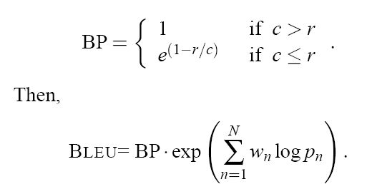
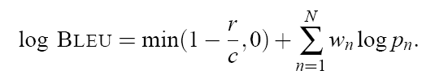
Formulae of BLEU Computation

Slide 154
An Example
  MT Hypothesis: the gunman was shot dead by police .
  Ref 1: The gunman was shot to death by the police .
  Ref 2: The gunman was shot to death by the police .
  Ref 3: Police killed the gunman .
  Ref 4: The gunman was shot dead by the police .
Precision: p₁=1.0(8/8) p₂=0.86(6/7) p₃=0.67(4/6) p₄=0.6 (3/5)
Brevity Penalty: c=8, r=9, BP=0.8825
Final Score:

Slide 155
NIST version
r: The average no. of words in a reference translation, average over all reference translations
c: The number of words in translation being scored
(Skipped here) NIST version also has different definitions of BP.

Slide 156
Experimental Evidence
Ranking provided by BLEU is the same as ranking provided by Human
  The result is statistically significant with pairwise t-statistics
BLEU can be used if there is only one single reference translation
BLEU shows that machine and human translation still have a big gap
BLEU has been used in multiple languages and shown to be useful

Slide 157
小结
BLEU值自从2002年提出以来，对机器翻译的评测起到了促进作用
但是，BLEU值只计算机器翻译和参考翻译的相似度而不是真正的准确度和流利度，因此当BLEU值改进不大的时候，不能说明问题
目前常用David Chiang提出的一种改进BLEU-SBP
其他新的评测方法也在不断地被提出来

Slide 158
作业
阅读后面的有关论文

Slide 159
projects
人名音译程序
专有名词翻译程序
探讨smt和分词的关系
对齐算法研究

Slide 160
SMT References
Best overall reference
Philipp Koehn, « Statistical Machine Translation », University of Edinburgh (textbook, Cambridge University Press).
Papers
Brown93 Peter F. Brown, Stephen A. Della Pietra, Vincent Della J. Pietra, and Robert L. Mercer. The mathematics of Machine Translation: Parameter estimation. Computational Linguistics, 19(2):263-312, June 1993.
Foster06 George Foster, Roland Kuhn, and Howard Johnson. Phrasetable Smoothing for Statistical Machine Translation. EMNLP 2006, Sydney, Australia, July 22-23, 2006.
Germann01 Ulrich Germann, Michael Jahr, Kevin Knight, Daniel Marcu, and Kenji Yamada. Fast decoding and optimal decoding for machine translation. In Proceedings of the 39th Annual Meeting of the Association for Computational Linguistics (ACL), Toulouse, July 2001.

Slide 161
References (2)
Knight99 Kevin Knight. Decoding complexity in word-replacement translation models. Computational Linguistics, Squibs and Discussion, 25(4), 1999.
Koehn04 Philipp Koehn. Pharaoh: a beam search decoder for phrase-based statistical machine translation models. In Proceedings of the 6th Conference of the Association for Machine Translation in the Americas, Georgetown University, Washington D.C., October 2004. Springer-Verlag.
KoehnDec03 Philipp Koehn. PHARAOH - a Beam Search Decoder for Phrase-Based Statistical Machine Translation Models (User Manual and Description). USC Information Sciences Institute, Dec. 2003.

Slide 162
References (3)
KoehnMay03 Philipp Koehn, Franz Josef Och, and Daniel Marcu. Statistical phrase-based translation. In Eduard Hovy, editor, Proceedings of the Human Language Technology Conference of the North American Chapter of the Association for Computational Linguistics (HLT/NAACL), pp. 127-133, Edmonton, Alberta, Canada, May 2003.
Marcu02 Daniel Marcu and William Wong. A phrase-based, joint probability model for statistical machine translation. In Proceedings of the 2002 Conference on Empirical Methods in Natural Language Processing (EMNLP), Philadelphia, PA, 2002.
OchJHU04 Franz Josef Och, Daniel Gildea, et al. Final Report of the Johns Hopkins 2003 Summer Workshop on Syntax for Statistical Machine Translation (revised version). http://www.clsp.jhu.edu/ws03/groups/translate (JHU-syntax-for-SMT.pdf), Feb. 2004.
Och04 Franz Och and Hermann Ney. The alignment template approach to statistical machine translation. Computational Linguistics, V. 30, pp. 417-449, 2004.
Och03 Franz Josef Och. Minimum error rate training for statistical machine translation. In Proceedings of the 41th Annual Meeting of the Association for Computational Linguistics (ACL), Sapporo, July 2003.

Slide 163
References (4)
Och02 Franz Josef Och and Hermann Ney. Discriminative training and maximum entropy models for statistical machine translation. In Proceedings of the 40th Annual Meeting of the Association for Computational Linguistics (ACL), Philadelphia, July 2002.
Och01 Franz Josef Och, Nicola Ueffing, and Hermann Ney. An Efficient A* Search Algorithm for Statistical Machine Translation. In Proc. Data-Driven Machine Translation Workshop, July 2001.
Och00 Franz Josef Och and Hermann Ney. A Comparison of Alignment Models for Statistical Machine Translation. Int. Conf. on Computational Linguistics (COLING), Saarbrucken, Germany, August 2000.
Ueffing02 Nicola Ueffing, Franz Josef Och, and Hermann Ney. Generation of Word Graphs in Statistical Machine Translation. Empirical Methods in Natural Language Processing, July 2002.

Slide 164
BLEU References
Kishore Panineni, Salim Roukos, Todd Ward and Wei Jing Zhu, BLEU, a Method for Automatic Evaluation of Machine Translation. In ACL-02. 2002
George Doddington, Automatic Evaluation of Machine Translation Quality Using N-gram Co-Occurrence Statistics.
Etiene Denoual, Yves Lepage, BLEU in Characters: Towards Automatic MT Evaluation in Languages without Word Delimiters.
Alon Lavie, Kenji Sagae, Shyamsundar Jayaraman, The Significance of Recall in Automatic Metrics for MT Evaluation.
Christopher Culy, Susanne Z. Riechemann, The Limits of N-Gram Translation Evaluation Metrics.
Santanjeev Banerjee, Alon Lavie, METEOR: An Automatic Metric for MT Evaluation with Improved Correlation with Human Judgments.
About T-test: http://mathworld.wolfram.com/Pairedt-Test.html
About T-distribution: http://mathworld.wolfram.com/Studentst-Distribution.html

